Slide 1

Cub Scout Shooting Sports
Circle ten Council
Range Masters Certification
Course Numbers:
Archery: cs31 - BB: course cs32
2/9/2019
Draft 2
1
Circle Ten Shooting Sports Committee

Slide 2

This is the Circle Ten Archery/BB Range Master Certification Course. It has been developed to train adult leaders on the setup and operation of a safe BB gun or archery range. The certifications received from this course or the NRA Rifle course for BBs or USA Archery Level 1 or better for archery is required to open an range in Circle Ten Council. This includes council and district activities.
The most important thing you should remember during and after this course is that Safety is the most import part of the program and that you, as the Range Master, are responsible for the safety of the range including setup and operation. Parents and guardians will be entrusting you with the safety of their children.
The certifications you receive is valid for two (2) years.
Note: In cub scouting, bow and arrows are not ‘Weapons’ and BB guns are not Weapons. Cub scouts do not use weapons and we should not refer to them as ‘Weapons’.
2/9/2019
Draft 2
2
Circle Ten Shooting Sports Committee

Slide 3
This course consist of three documents
  Range Master Course (This Document)
  Archery Range Manual
  BB Range Manual
Range manuals are designed for use on the range. They cover all the information that should be covered in a safety briefing. It is a good idea to used this document for all your safety briefings.
Much of the information from this course comes from other BSA documents including Boy Scouts National Shooting Sports Manual and Cub Scout Shooting Sports Guide. Both can be found on line and should be reviewed. Links to some videos from NRA and YouTube are also include.
You can download the most up-to-date copy of the course material and range manuals from the Circle Ten Shooting Sports website:
https://www.c10shootingsports.org
2/9/2019
Draft 2
2
Circle Ten Shooting Sports Committee

Slide 4
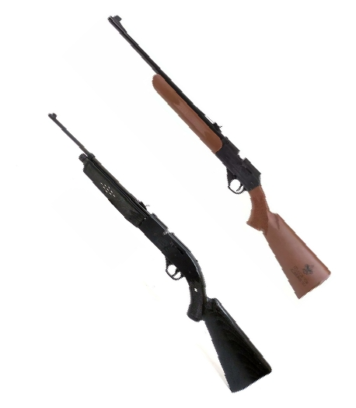
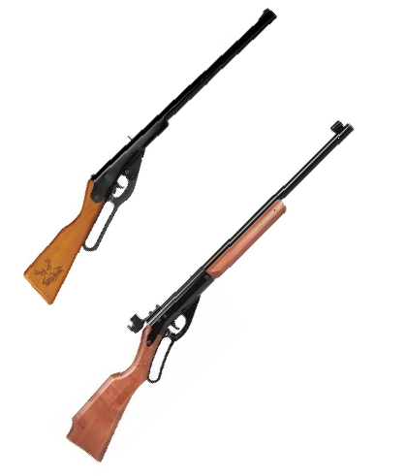
Types of BB Guns
The two major types of BB guns available
Spring-Piston gun
Pneumatic gun
Single-stroke
Multi-pump pneumatics
Compressed C02
Restrictions for Cub Scouts:
.177 caliber BB Gun
Velocity of 350 feet per second or less
(Pelets and higher velocity are allowed in Webelos, but
require a NRA certified instructor)
Spring-Piston
Pneumatic
2/9/2019
Draft 2
3
Circle Ten Shooting Sports Committee

Slide 5
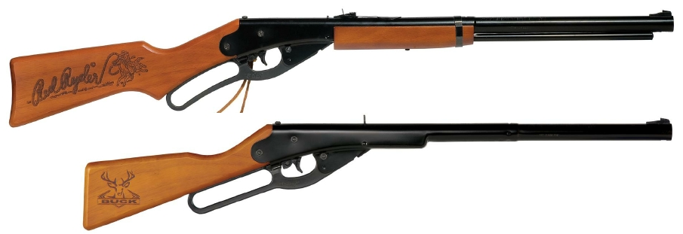
Spring Piston
Spring-Piston: The most common BB guns uses for Cub Scouts are the Daisy Red Ryders
(model 1938) and Daisy Bucks (model 105). For smaller scouts the Buck is a better fit.
Capacity is approximately 400 BBs. These guns have a maximum velocity of 350 feet per
second and shoots .177 BBs, which is the requirement for cub scouts
Note: One of the best ways to learn about a BB
gun and how it operates is to read the Owners
Manual. Most are available online.
2/9/2019
Draft 2
4
Circle Ten Shooting Sports Committee

Slide 6
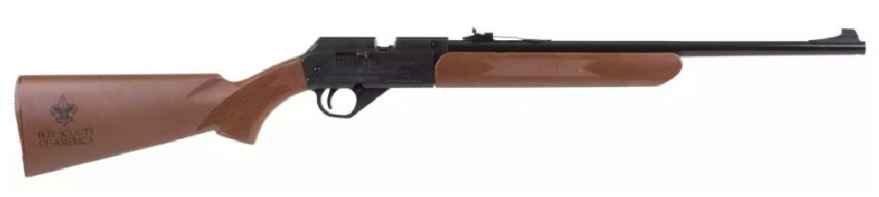
Pneumatic
The official BSA pneumatic BB gun is the Daisy Model 1910. This is a single pump that
meets the requirement for Cub Scouts. It also has a velocity of 350 feet per second and
shoots .177 BBs. Capacity is approximately 50 BBs.
Note: This is probably best for older cub scout
2/9/2019
Draft 2
5
Circle Ten Shooting Sports Committee

Slide 7
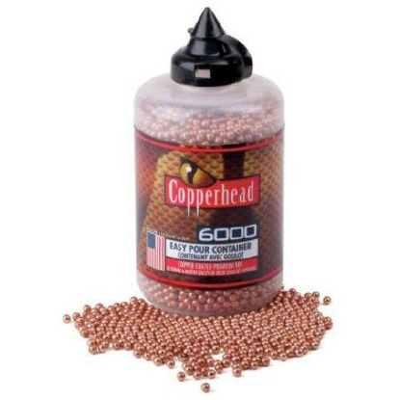
Amunition
USING THE PROPER AMUNITION
For Cub Scouts, the only ammunition used use is a .177
caliber BB.
REUSE OF BBs
Never reuse air gun pellets or BBs. These types of projectiles
are easily deformed upon impact with a target, and can cause
damage to the air gun if reused.
STORAGE OF BBs
For safety reasons, ammunition should always be stored
separately from the air gun and not accessible to unauthorized
persons.
2/9/2019
Draft 2
6
Circle Ten Shooting Sports Committee

Slide 8
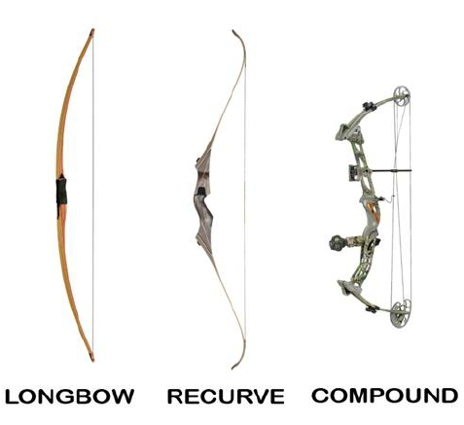

Types of Bows
Recurve bows are the traditional bow for learners. It allows the archer to better learn proper finger tension. Modern
recurve bows are either made entirely of fiberglass, or are a composite of wood and fiberglass. Both options are
satisfactory for beginning instruction.
Compound bows are generally harder to master, but they will produce more consistent results. The pulley system
provides a mechanical advantage to assist where strength or stamina is an issue.
Training bows are typically recurve but could be a longbow or compound bow. They are usually less expensive
and require less strength to use. The type of bow used should be matched to the capabilities and abilities of the
scouts using them.
TRAINING
2/9/2019
Draft 2
7
Circle Ten Shooting Sports Committee

Slide 9
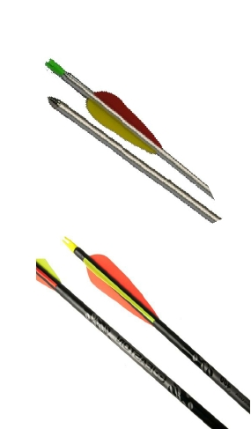
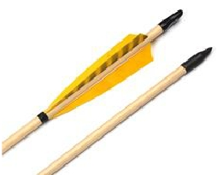
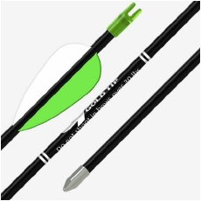
Some Types of Arrows
Wooden (Port Oxford Cedar)
Aluminum
Fiberglass
Carbon Fiber
Nock of the arrow must match the bow string and
the length of the arrow should be appropriate for
the bow being used.
Draft 2
2/9/2019
Circle Ten Shooting Sports Committee
8

Slide 10



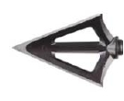
Types of Arrows Points
Target points
Use field points for target practice and small game hunting.
Field points
Use field points for target practice and small game hunting.
Blunt points
Use blunt points for small game; they are made of metal or rubber.
Hunting Broadhead
Use bullet points for target practice.
2/9/2019
Draft 2
9
Circle Ten Shooting Sports Committee

Slide 11
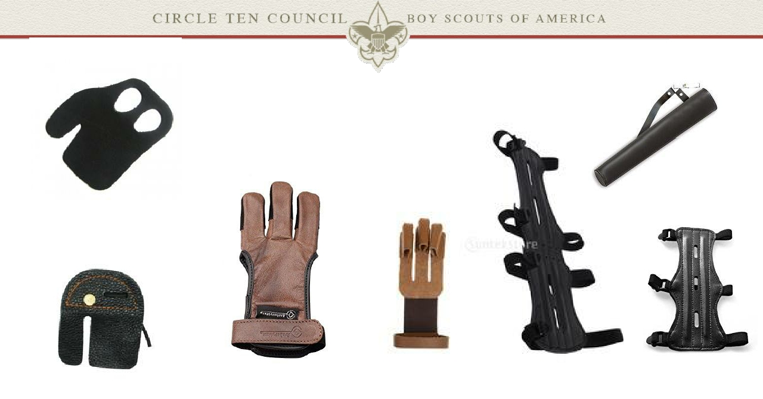
Archery Accessories
2/9/2019
Draft 2
10
Circle Ten Shooting Sports Committee

Slide 12
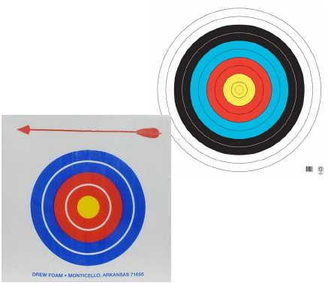
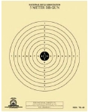
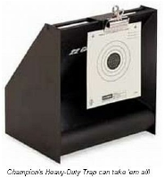
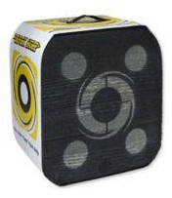
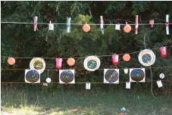
Some Types of Targets
Many animal targets are available with rabbits, bears, duck, dear, etc. but cubs do not shoot representations of living
creatures. What does make a good target? Circles! When selecting and setting up targets consider the possibility of
ricochet for bbs and possible damage to the arrows for archery.
2/9/2019
Draft 2
11
Circle Ten Shooting Sports Committee

Slide 13
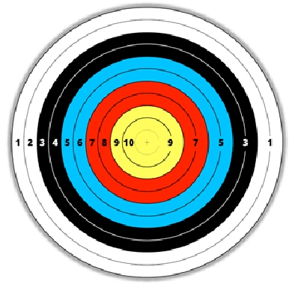
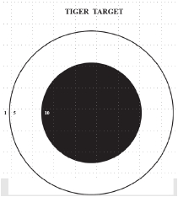
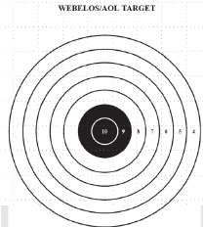
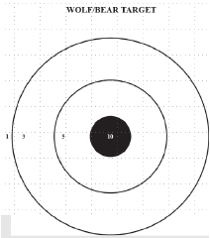
Target Scoring
If scoring, use targets with numbers. Targets should be appropriate for age group, but in many cases, all scouts will
be using the same type of target. When there I doubt about the score of an arrow or bb, count the higher number.
For example if a bb went mostly in the 9, but did tare the paper in the 10 area, it ’s a 10 or if an arrow is touching the
line between a 9 and 10, it ’s a 10.
2/9/2019
Draft 2
12
Circle Ten Shooting Sports Committee

Slide 14
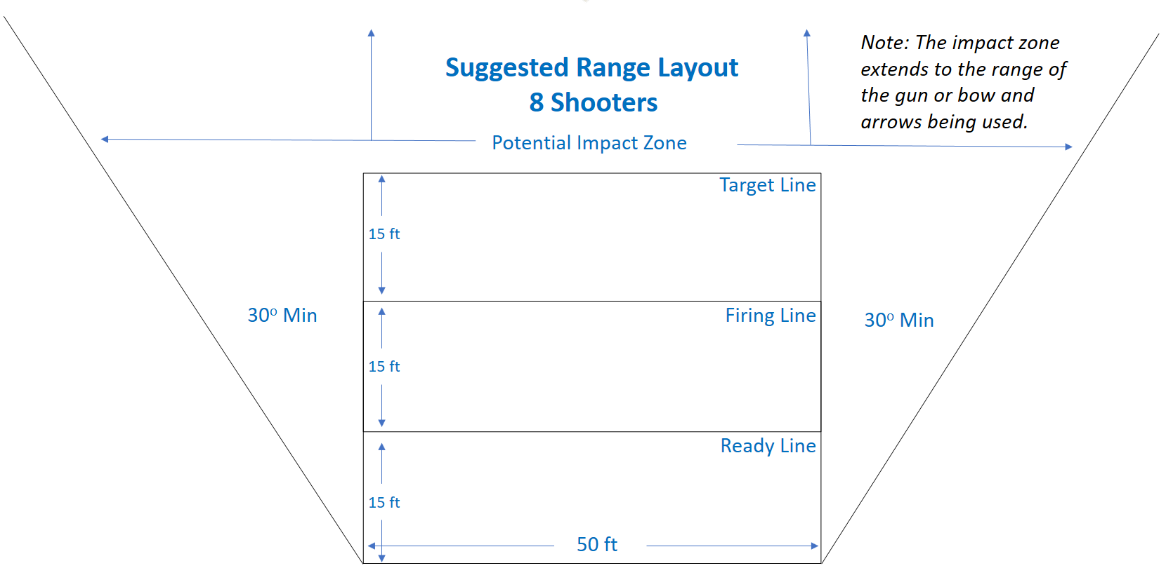
2/9/2019
Circle Ten Shooting Sports Committee
13

Slide 15
Suggested Range Layout
8 Shooters
Left
Range
Guard
Right
Range
Guard
1 trained instructor per 8 shooters
(range assistants should be available to help
with any issues and range guards to help watch
the range)
2/9/2019
Draft 2
14
Circle Ten Shooting Sports Committee

Slide 16
2/9/2019
Draft 2
15
Circle Ten Shooting Sports Committee

Slide 17
General Safety Rules
        Ranges may be opened only by a qualified range master.
        Know your target and what is beyond.
        Be sure the guns or bows and arrows are safe to operate.
        Know how to use them safely.
        Use only the correct ammunition or arrows.
        Never use alcohol or drugs before or while shooting.
        Store so they are not accessible to unauthorized persons.
Be aware that certain types of guns and bows as well as many shooting activities require additional safety precautions.
Video
Circle Ten Shooting Sports Committee

Slide 18
Equipment Check
Before you allow any shooters to use any of the equipment on you
range, make sure that it is safe.
Inspect each bow, arrow, gun etc. Make sure they are in good condition
and are functioning properly.
If you find a piece of equipment that is not safe or not functioning as
required, set it aside. Do not use it. Notify the appropriate person,
ranger or camp director, so supplies can be refurbished.
2/9/2019
Draft 2
16
Circle Ten Shooting Sports Committee

Slide 19
Range Operation
1. Shooters into the briefing area - It is best to limit the number of shooters to the number of shooting
positions available.
2. Safety Briefing – Cover the safety briefing material. Make sure the shooters know about the ready line and
how to find their position on the ready line.
3. Invite the shooters to enter the range – Each shooter should locate a position on the ready line. For BBs,
anyone entering the range should be wearing glasses; prescription, sun glasses or safety glasses are good.
4. Shooting stations - Make sure each knows which gun or bow and target they will be using and that they
know not to touch until they are told to.
5. Bring the shooters to the firing line and have them take their shooting positions. Again, remind them not to
touch until they are told to.
6. Range commands to make sure the range is ready and to allow the shooters to commence fire.
7. Use Cease Fire stop the shooting. At Cease Fire, each shooter should immediately put the gun or bow down.
8. Return shooters to the ready line.
9. Insure the ranges is save. Guns should be in a condition that they can not be accidently fired.
10. Allow shooter to exchange their targets with a new one and/or retrieve arrows then exit the range at the exit
location.
11. In most cases, go to 1 an start over with more shooters.
2/9/2019
Draft 2
17
Circle Ten Shooting Sports Committee

Slide 20
The next portions of the course is base on our Range Manuals. They were designed to be
printed and used by the instructor during the safety briefing before each shooting activity.
Safety briefings are required before every shooting activity.
Again, remember responsibility of the safety on the range belongs to you, the range master.
That is your primary responsibility. Assistance should be available to assist with any issues
during shooting.
Suggested Safety/Range Briefing Agenda
1.
2.
3.
4.
5.
6.
7.
Not toys
Safety rules
Before you use
BBs,You found a gun what do you do
Parts
Shooting Fundamentals
Range Commands
2/9/2019
Draft 2
18
Circle Ten Shooting Sports Committee

Slide 21
Cub Scout BB GUN
RANGE MANUAL
2/9/2019
Draft 2
19
Circle Ten Shooting Sports Committee

Slide 22
Cub Scout Archery
RANGE MANUAL
2/9/2019
Draft 2
20
Circle Ten Shooting Sports Committee

Slide 23
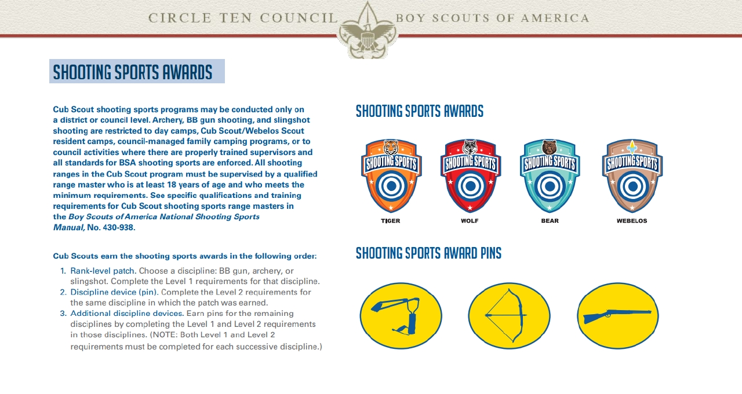
2/9/2019
Draft 2
21
Circle Ten Shooting Sports Committee

Slide 24
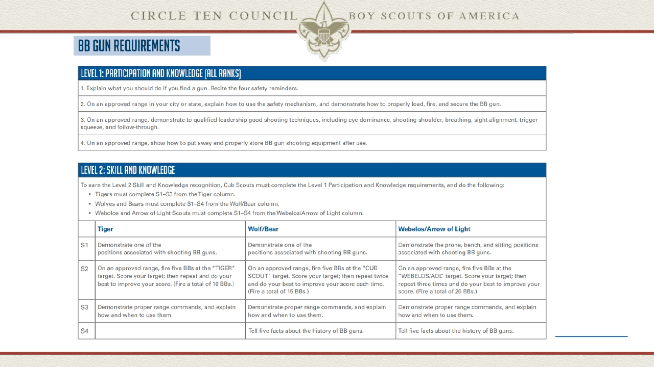
Full Document
22
2/9/2019
Draft 2
Circle Ten Shooting Sports Committee

Slide 25
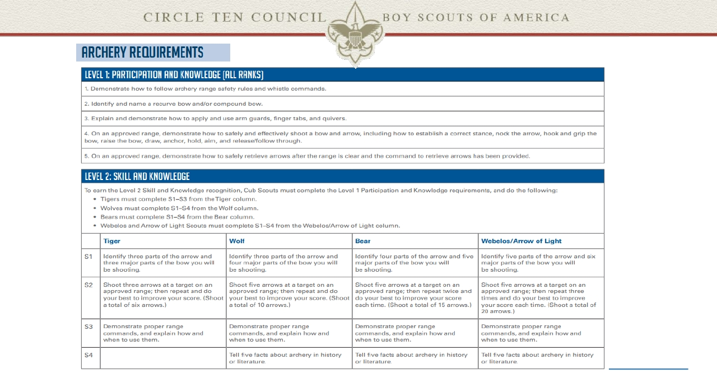
Full Document
23
2/9/2019
Draft 2
Circle Ten Shooting Sports Committee

Slide 26
Your Turn
Based on what your learned,
1. Build a safe a range.
2. Operate it.
Every thing works better with practice. Each of you will
get a chance to practice you new skills.
Draft 2
2/9/2019
Circle Ten Shooting Sports Committee
24

